Slide 1

“Market Paradigms”

Slide 2
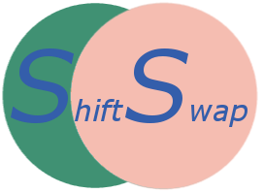
The Idea
Shift Swap is a new software designed and developed by Agile Technology to be all you need and more for improving your business. Developed with small and medium businesses in mind, Shift Swap makes it easier and quicker for everyone in your business to manage their busy schedules and maximize your profits.

Slide 3
Project Breakdown
Features
- Secure login with password encryption
Multi-level schedule viewing for managers and employees
Trade, add, emove, and increase shifts
Ability to reply to messages and requests from other users

Slide 4
Project Breakdown
Use Cases
- Employees will be able to check, manage and change their shift schedule
- Their managers have the ability to manage all users shifts and assign new shifts
- Owners will be able to promote and remove users of the system

Slide 5
Project Breakdown
Technologies
- SQL database
- Java Applet for web deployment
- MD5 Encryption for Passwords

Slide 6
Current Progress
Database is partially up and running
Login Screen
Database integration

Slide 7
Work Breakdown
-Controller and Request Management
-Database
-User Interface
-Request generation and interpretation
-User accounts
-Schedule lookup
-Managers Adding hours to the schedule

Slide 8
The Plan
We plan on segmenting the work, and slowly building up our codebase, building from test cases and a skeleton implementation (dummy functions)

Slide 9
Risks and Challenges
Time is always a factor, with other projects and work to be done outside of this project finding time, especially at the end of the semester will be a challenge.
Technological integration, making sure the database and java applet work together properly.

Slide 10
Conclusion
From personal experience, a quickly usable system to check and manage a schedule is not only helpful but necessary for business optimality.
Our project aim is simplicity so that as little time is spent using the system, while not cutting down of functionality.

